Slide 1
Taichi IR global optimizations
Mingkuan Xu
GitHub: @xumingkuan

Slide 2
Motivation
Why optimize Taichi IR? Can't we leave the job to LLVM?
Higher optimization quality: LLVM doesn't have the same level of knowledge as we do.
Fewer instruction to LLVM: improve LLVM compilation speed.

Slide 3
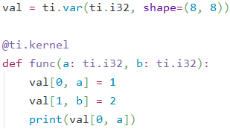
We know val[0, a] is not val[1, b], so the value to print must be 1.
However, LLVM doesn’t know val[0 * 8 + a] is not val[1 * 8 + b].

Slide 4
What optimizations do we have now?
We only have local optimizations: optimizations within a basic block.
Basic block: straight-line sequence of statements
no control flow into or out of middle of sequence

Slide 5
Limitations of current optimizations
$1 = alloca (local temporary variable)
$2 = const [10]
$3 : local store [$1 <- $2]
$4 : if … {
$5 = local load [$1]
$6 = $5 + …
}
$1 = alloca (local temporary variable)
$2 = const [10]
$3 : local store [$1 <- $2]
$4 : if … {
$6 = $2 + …
}
We need global store-to-load forwarding!
Global: look at the entire procedure instead of a basic block.

Slide 6
Limitations of current optimizations
$1 = alloca (local temporary variable)
$2 = const [10]
$3 : local store [$1 <- $2]
$4 : if … {
(doesn’t modify $1)
}
$5 = local load [$1]
$6 = $5 + …
$1 = alloca (local temporary variable)
$2 = const [10]
$3 : local store [$1 <- $2]
$4 : if … {
(doesn’t modify $1)
}
$6 = $2 + …
We need global store-to-load forwarding!
Global: look at the entire procedure instead of a basic block.

Slide 7
Limitations of current optimizations
$1 = alloca (local temporary variable)
$2 = const [10]
$3 : if … {
$4 : local store [$1 <- $2]
}
(doesn’t load $1)
$1 = alloca (local temporary variable)
$2 = const [10]
$3 : if … {
}
We need global store elimination!

Slide 8
Limitations of current optimizations
$1 = alloca (local temporary variable)
$2 = const [10]
$3 : local store [$1 <- $2]
$4 : if … {
$5 = const [1]
$6 : local store [$1 <- $5]
} else {
$7 = const [2]
$8 : local store [$1 <- $7]
}
$1 = alloca (local temporary variable)
$2 = const [10]
$4 : if … {
$5 = const [1]
$6 : local store [$1 <- $5]
} else {
$7 = const [2]
$8 : local store [$1 <- $7]
}
We need global store elimination!

Slide 9
Limitations of current optimizations
$1 = global tmp var (offset = 0 B)
$2 = const [0]
$3 : global store [$1 <- $2]
$4 = global tmp var (offset = 0 B)
$5 : global store [$4 <- $2]
$1 = global tmp var (offset = 0 B)
$2 = const [0]
$3 : global store [$1 <- $2]
We need aliasing analysis!

Slide 10
How to improve?
Systematically analyze each variable, do store elimination and store-to-load forwarding at the level of the entire procedure (kernel).
LLVM uses a control-flow graph to analyze.
We use a state machine for each variable:
Is it loaded/stored? (State: never/maybe/definitely)
What’s the last store? Is it forwardable? Is it eliminable?
When we encounter an if, we “fork” all state machines and merge them after the if.

Slide 11
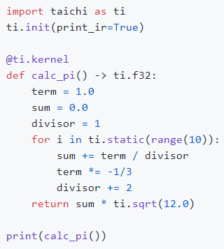
Constant Folding (by @archibate)
JIT compilation/evaluation
Cache the kernels with the same operator and operand data type
$1 = const [3.1415904]
$2 : kernel return $1

Slide 12
Verification
It is extremely easy to generate malformed IRs when writing optimizations
Verify that the IR is well-formed
Found a bug that has existed since Jan 29!
A statement’s parent should be the block it belongs to, but there are some statements with parent == nullptr.
Malformed IR example:
$1 : if … {
$2 = alloca
…
} else {
$3 = local load [$2] (illegal)
}

Slide 13
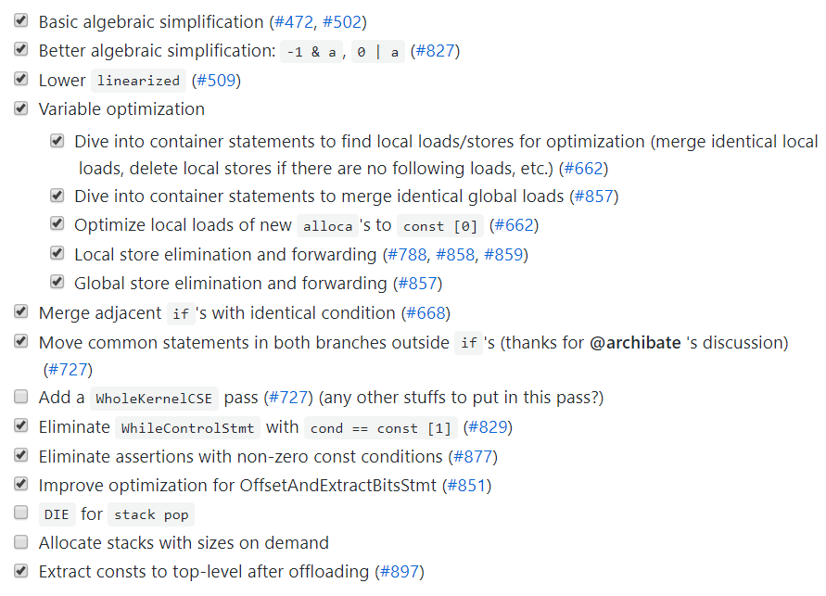
Lots of optimizations

Slide 14
Benchmark
Running time | mpm99 |  | Cornell box
 | GPU (100000 steps) | CPU (10000 steps) | GPU (1000 steps) | CPU (100 steps)
Optimization off: | 20.19s | 48.50s | 111.75s | 101.76s
Optimization on: | 12.33s | 48.18s | 111.51s | 100.13s
Improvement: | 1.64x | 1.01x | 1.00x | 1.02x
Significant improvement of mpm99 on CUDA (1.64x)
Tested at commit 65c151a0 on May 15, 2020.

Slide 15
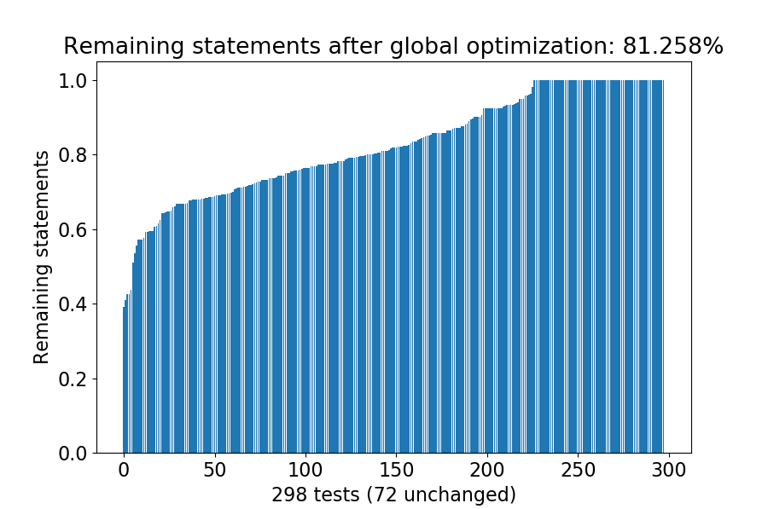
Benchmark
18.7% shorter code on average of 298 unit tests

Slide 16
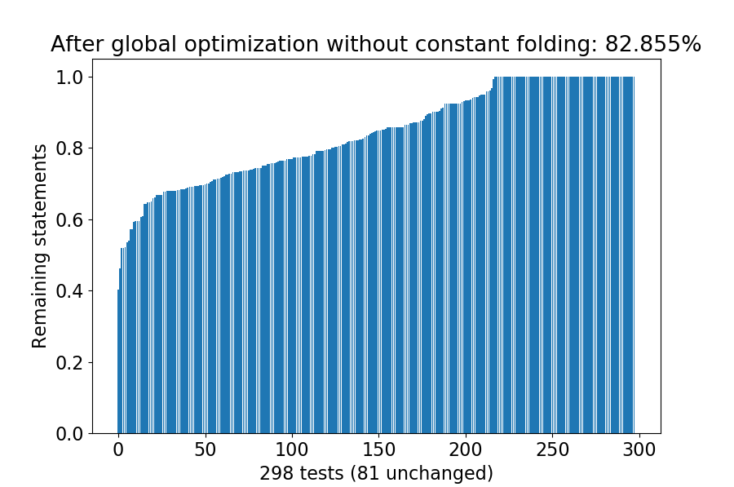
Without constant folding?
After removing constant folding, 18.7% -> 17.1% shorter code on average of 298 unit tests
Only 54/298 unit tests are affected by constant folding

Slide 17
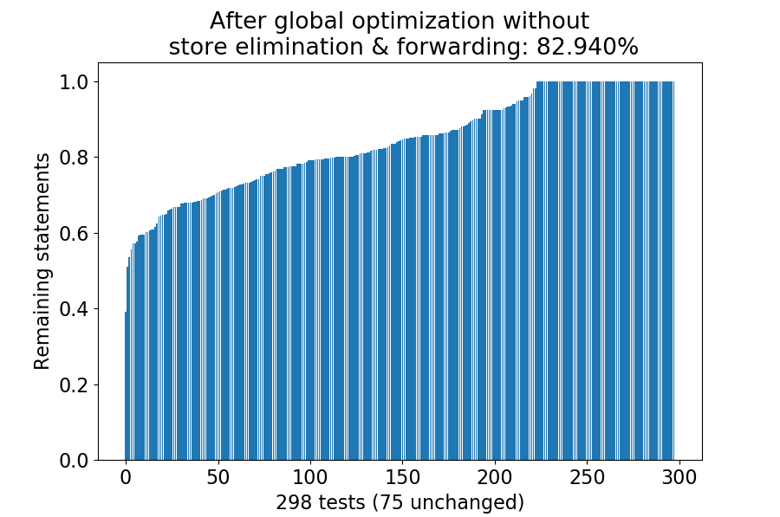
Without store elimination & forwarding?
After removing store elimination & forwarding, 18.7% -> 17.1% shorter code on average of 298 unit tests
Only 48/298 unit tests are affected by store elimination & forwarding

Slide 18
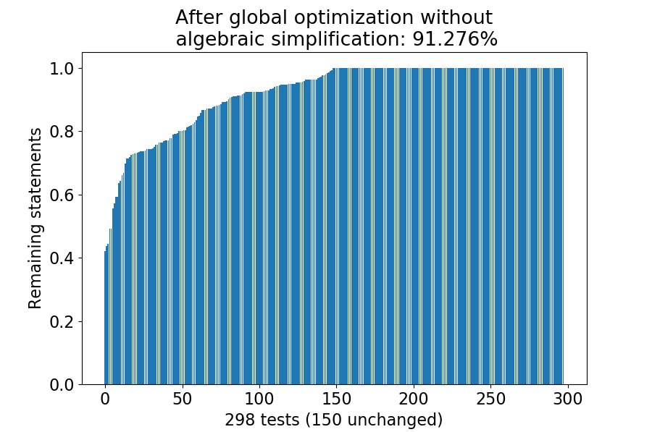
Which pass optimizes the most statements?
Algebraic simplification!
177/298 unit tests are affected by algebraic simplification

Slide 19
Algebraic simplification
a + 0 -> a
a – 0 -> a
a * 1 -> a
a / 1 -> a
a * 0 -> 0
a and -1 -> a
a or 0 -> a
a xor 0 -> a

Slide 20
Conclusion
Simple optimizations may be more useful than we thought
Optimization effects may differ dramatically on CPU/GPU and on different programs
Global optimizations are better than only local optimizations
More optimization opportunities at interprocedural scope?

